Slide 1
MEDICAL INSURANCE COST PREDICTION
BY
SUDHARSAN D

Slide 2
PROBLEM STATEMENT
Health insurance is a type of insurance that covers medical expenses that arise due to an illness. These expenses could be related to hospitalization costs, cost of medicines or doctor consultation fees. The main purpose of medical insurance is to receive the best medical care without any strain on your finances. Health insurance plans offer protection against high medical costs.
OBJECTIVE: Insurance Forecast by using Regression Algorithms

Slide 3
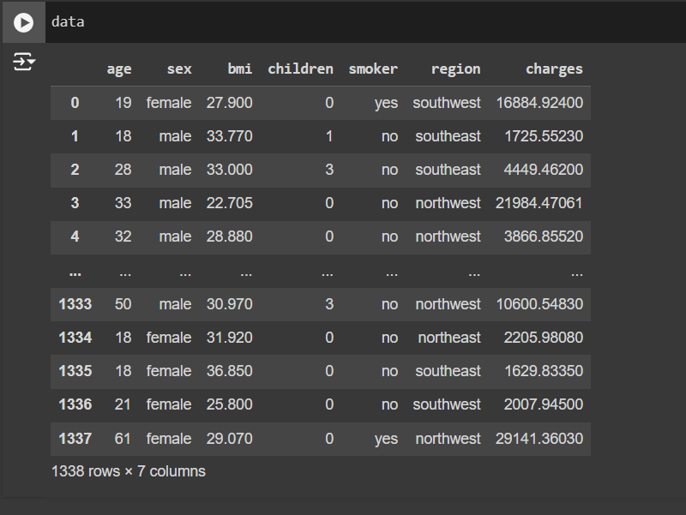
DATASET OVERVIEW
There are 7 pieces of information for each person:
Their age.
Whether they smoke.
The region they live in.
Whether they are male or female.
Their BMI, which helps to know if their weight is healthy.
How many children they have.
Their insurance charges, showing how much they pay for medical care.

Slide 4
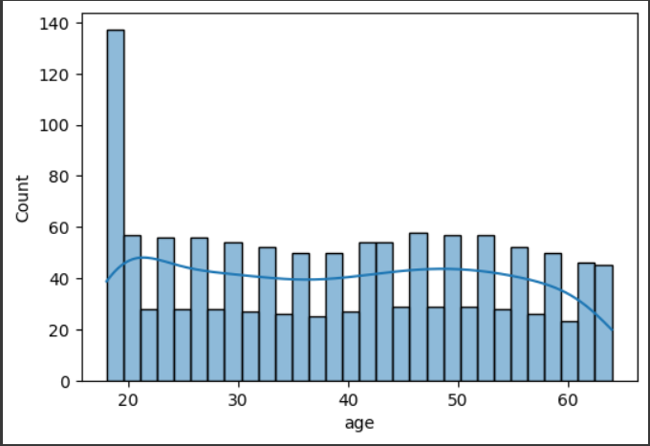
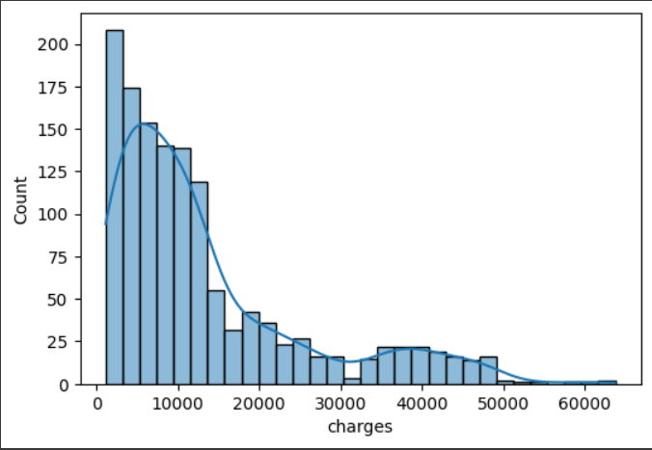
DATA VISUALIZATION
Distribution of variables such as age, BMI, and charges

Slide 5
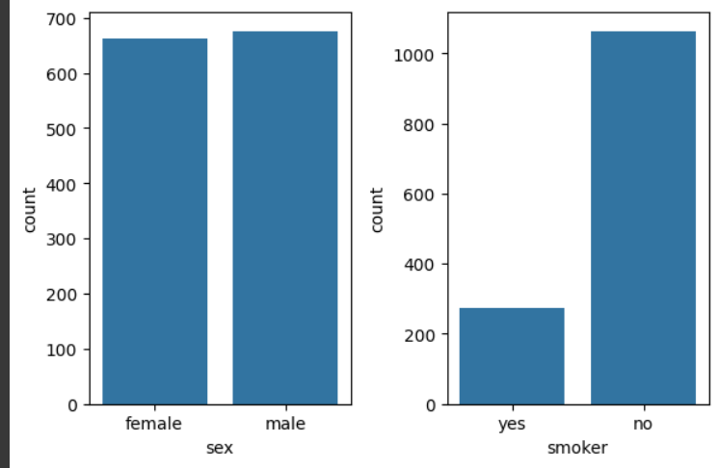
DATA PRE-PROCESSING
Handling Missing Values.
Bar Plot for Categorical Variables.
Handling outliers using Boxplot on BMI.
Encoding Categorical Variables.
Feature Scaling: Min-Max scaling.
Splitting the Data.
Bar Plot for Categorical Variables.

Slide 6
ALGORITHM SELECTION
Liner Regression.
Support Vector Machine.
Random Forest Regression
Decision Tree Regression
Perform cross-validation on each algorithm and show overfitting.
Hyper parameter tuning applied to the best algorithm

Slide 7
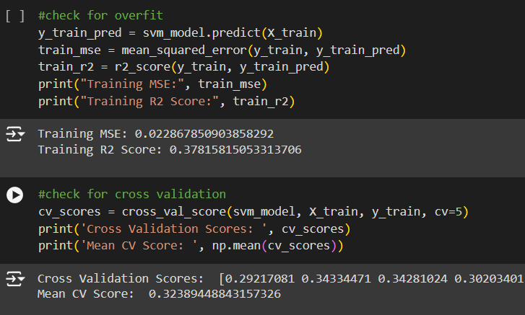
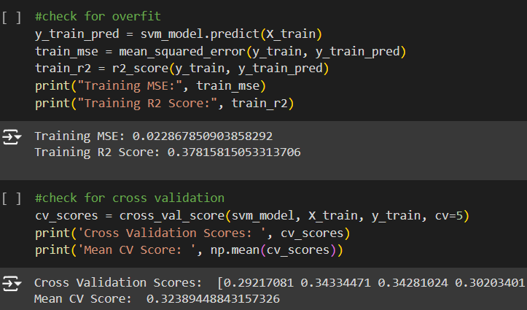
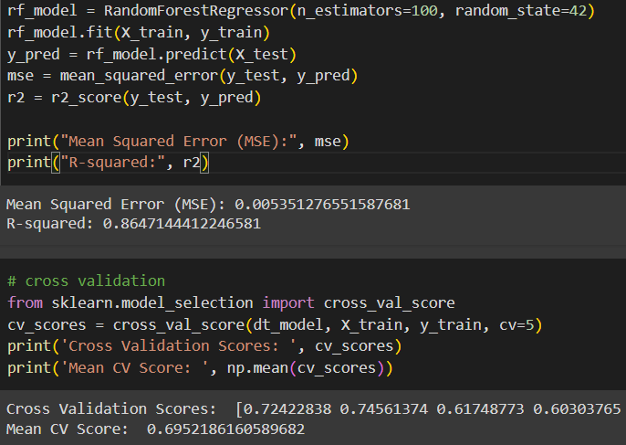
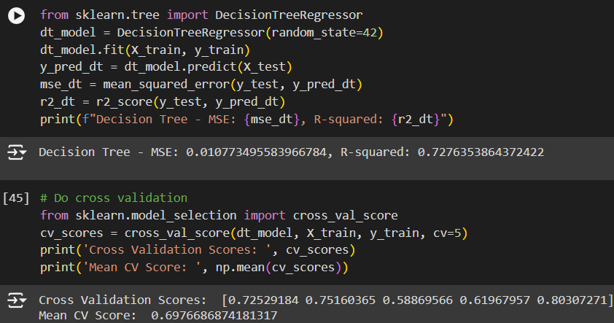
MODEL TRAINING & EVALUATION
LINEAR REGRESSION
SUPPORT VECTOR MACHINE
RANDOM FOREST REGRESSION
DECISION TREE

Slide 8
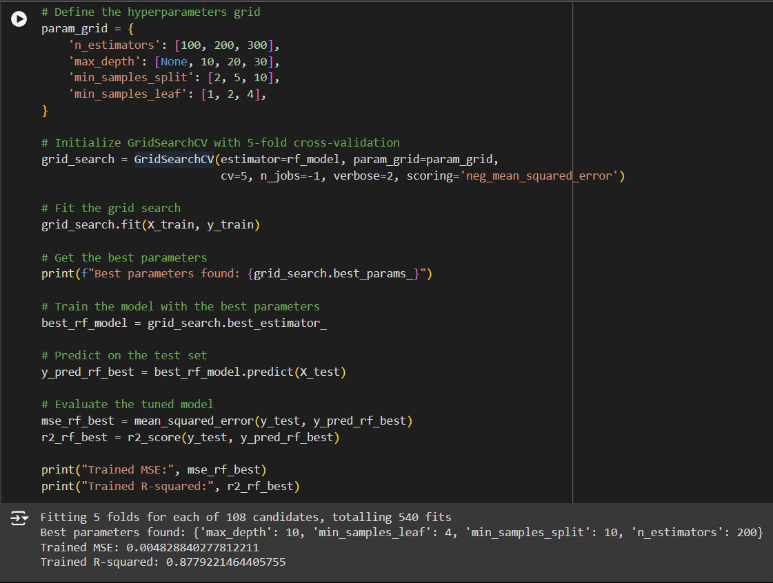
HYPER PARAMETER TUNING

Slide 9
THANK YOU

